Slide 1
Moneyball 2.0
An Examination of America’s Pastime
Shawn Williams
Mark Williams

Slide 2
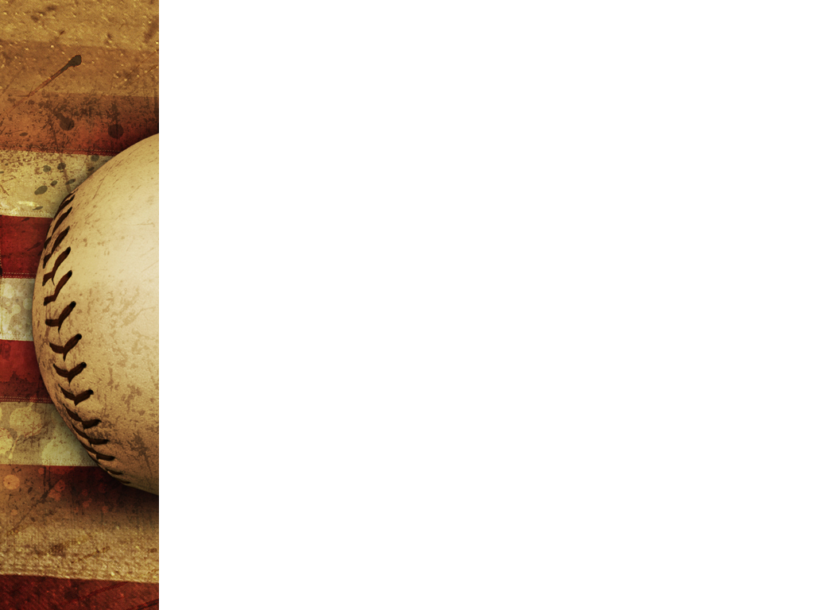
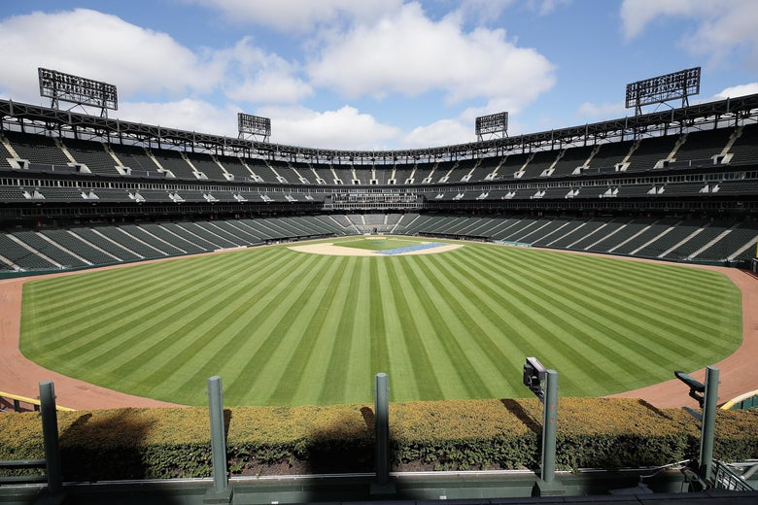
Project Purpose
Extracted MLB data from (1969-Present)
Determined which statistical categories were relevant to our overall objective
Built models to predict WS winners by team and league from (’15 -’20)

Slide 3
Models
SVM
RandomForestClassifier
Neural Network
Used Test, Train, Split and StandardScaler
Features (21)
Year, League, Total Games, Home Games, Wins, Losses, Winning %,
Won World Series, Runs, At Bats, Hits, Doubles, Triples, Homeruns,
Base by Ball, strikeouts, complete games, Stolen Bases, ERA, Shutouts, Saves, name
Classes (names, n=36)
Anaheim Angels, Arizona Diamondbacks, Atlanta Braves, Baltimore Orioles, Boston Red Sox, California Angels, Chicago Cubs, Chicago White Sox, Cincinnati Reds, Cleveland Indians, Colorado Rockies, Detroit Tigers, Florida Marlins, Houston Astros, Kansas City Royals, Los Angeles Angels of Anaheim, Los Angeles Dodgers, Miami Marlins, Milwaukee Brewers, Minnesota Twins, Montreal Expos, New York Mets, New York Yankees, Oakland Athletics, Philadelphia Phillies, Pittsburgh Pirates, San Diego Padres, San Francisco Giants, Seattle Mariners,
St. Louis Cardinals, Tampa Bay Devil Rays, Tampa Bay Rays, Texas Rangers,
Toronto Blue Jays, Washington Nationals, Washington Senators

Slide 4
Models(cont’)
SVM
Feature selection (16)
Wins, Losses, Winning %, Won World Series, Runs, At Bats, Hits, Doubles, Triples, Homeruns, Base by Balls, Stolen Bases, Strikeouts, ERA, Shutouts, Saves, name
Parameter
Linear Kernel
‘C’ parameter - 500
‘gamma’ – 0.0001
Training accuracy – 0.13 (0.74 for Divisions)
Testing accuracy – 0.18 (0.72 for Divisions)
Results
No correct results. No teams in playoffs.

Slide 5
Models(cont’)
RandomForestClassifier
Feature selection (15)
Wins, Losses, Winning %, Won World Series, Runs, Hits, Doubles, Triples, Homeruns, Base by Balls, Stolen Bases', Strikeouts, ERA, Shutouts, Saves, name
Parameters
‘bootstrap’ - True
‘max depth’ – 40
‘n-estimator’ – 500 (1000 for Division)
Testing accuracy – 0.20 (0.71 for Division)
Results
Pick Toronto for 2015. Toronto lost to Royals in ALCS.
No other teams made playoffs

Slide 6
Models (cont’)
Neural Network Model
Feature selection (14)
Wins, Losses, Winning %, Won World Series, Runs, Hits, Doubles, Triples, Homeruns, Base by Balls, Stolen Bases', ERA, Shutouts, Saves, name
Parameters
18 inputs, activation = ‘relu’
1 hidden layer (100 nodes)
36 outputs
Training accuracy – 0.51
Testing accuracy – 0.16
Results
Picked Royals (WC Winner) for 2015.
No other teams made playoffs

Slide 7
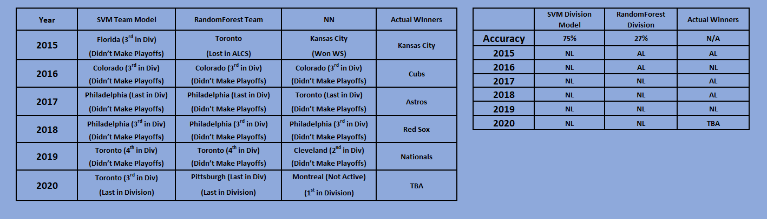
Model Results

Slide 8
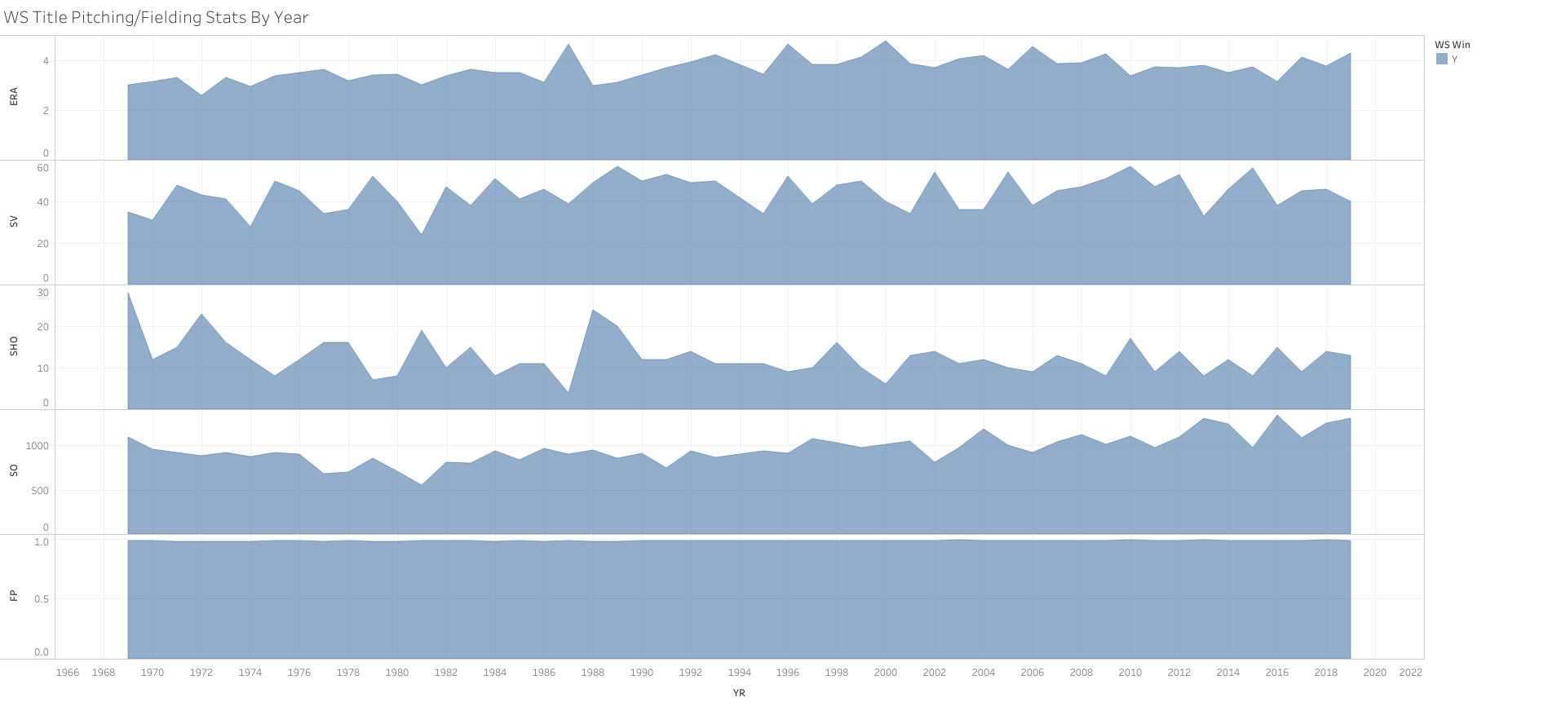
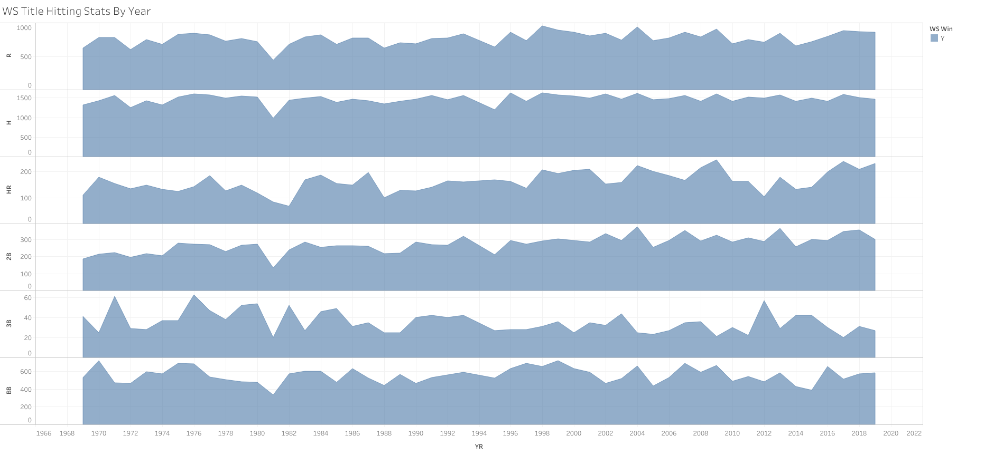
Visuals

Slide 9
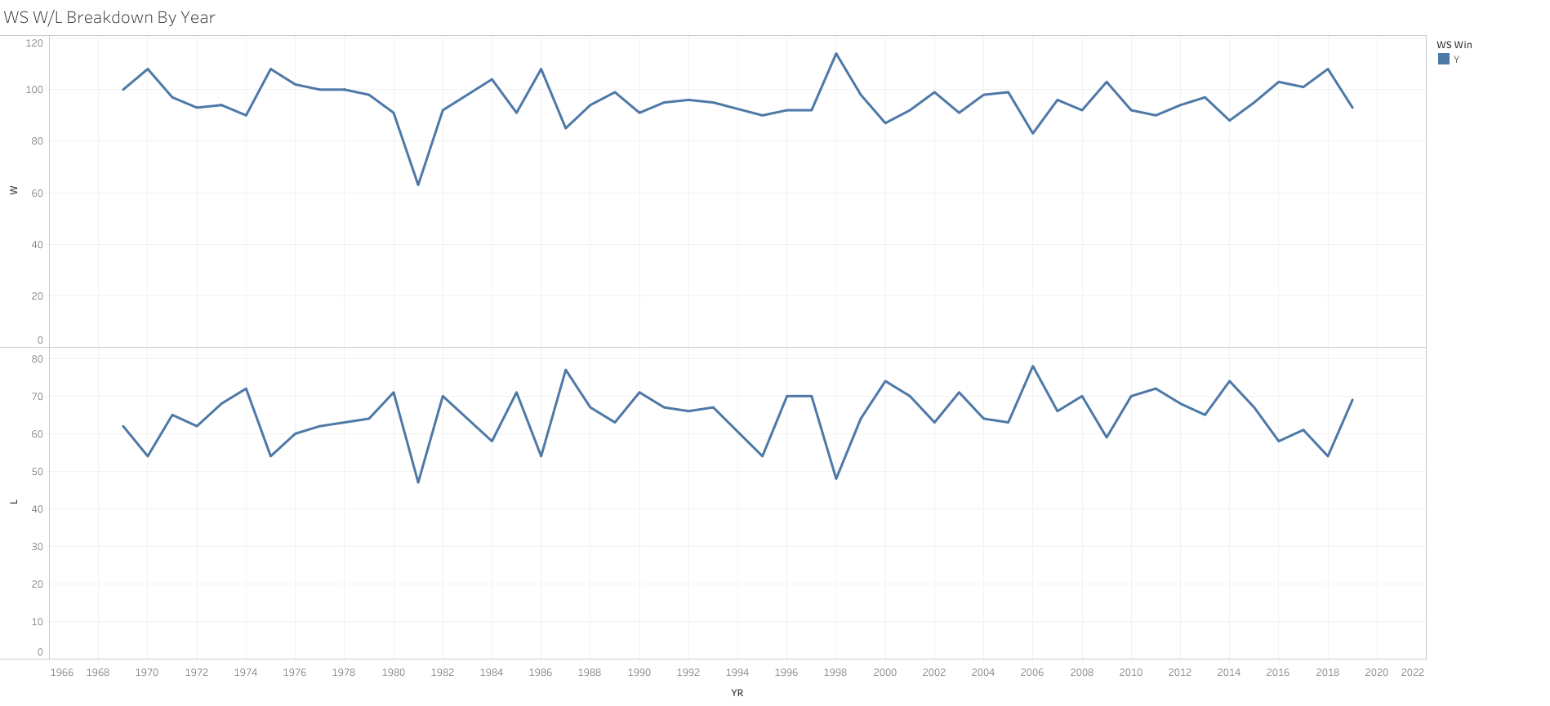
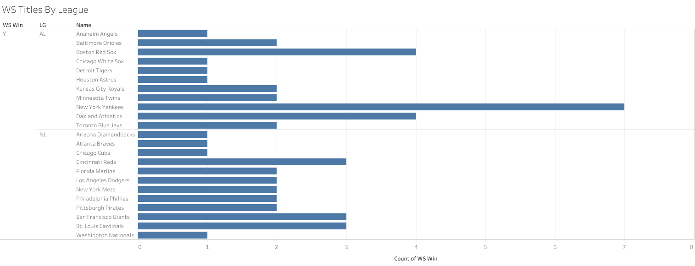
Visuals Cont’d.

Slide 10
HTML

Slide 11
Project Considerations
Lessons
Additional inputs/features (increase accuracy)
Less outputs
More data
Ensure outcomes included in each yr.
Look at individual games instead of seasons
Questions
Why did neural network pick Montreal for 2020?
Why were most of the picks in the center of their respected division?
Why were last place teams picked?

Slide 12
Conclusion
Requiring 36 outputs yields 0.20 accuracy (2 outputs yield > 0.70)
Neural Network appears to be the better model
2015 Neural Network accurately picked the World Series Champ, and RandomForest picked Toronto (Made it to ALCS)
Overall, the models were a poor indicator of winners

Slide 13
Project Sources
http://www.seanlahman.com/baseball-archive/statistics (MLB Data)
https://slate.com/news-and-politics/2020/06/mlb-players-restart-2020-baseball-season-schedule-rules-changes-spring-training.html (PP Image)
https://www.mlb.com/stats/ (MLB Data)

